Slide 1
Babylon Studio
Levian González, Adriana Torres, Andrés De Pereda and Daniel Marchán

Slide 2

Name

Slide 3
Purpose
Storage of clinical histories
Access to clinical histories of patients
Enables the patients to check their appointments and ask for one
Enables the doctors to check their pending appointments
Enables the doctors to update the patients´clinical histories

Slide 4
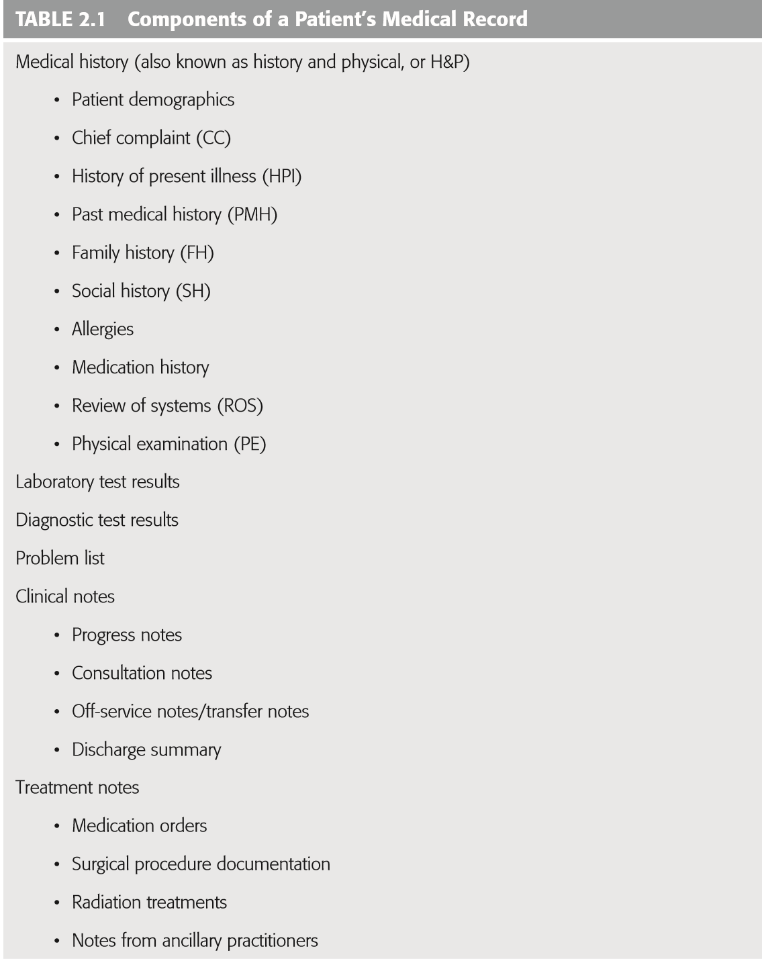
ER Diagram
Patient
Address
Doctor
Appointment
Allergies
Vaccines
Surgeries
Treatment
Illnesses
Clinical history

Slide 5
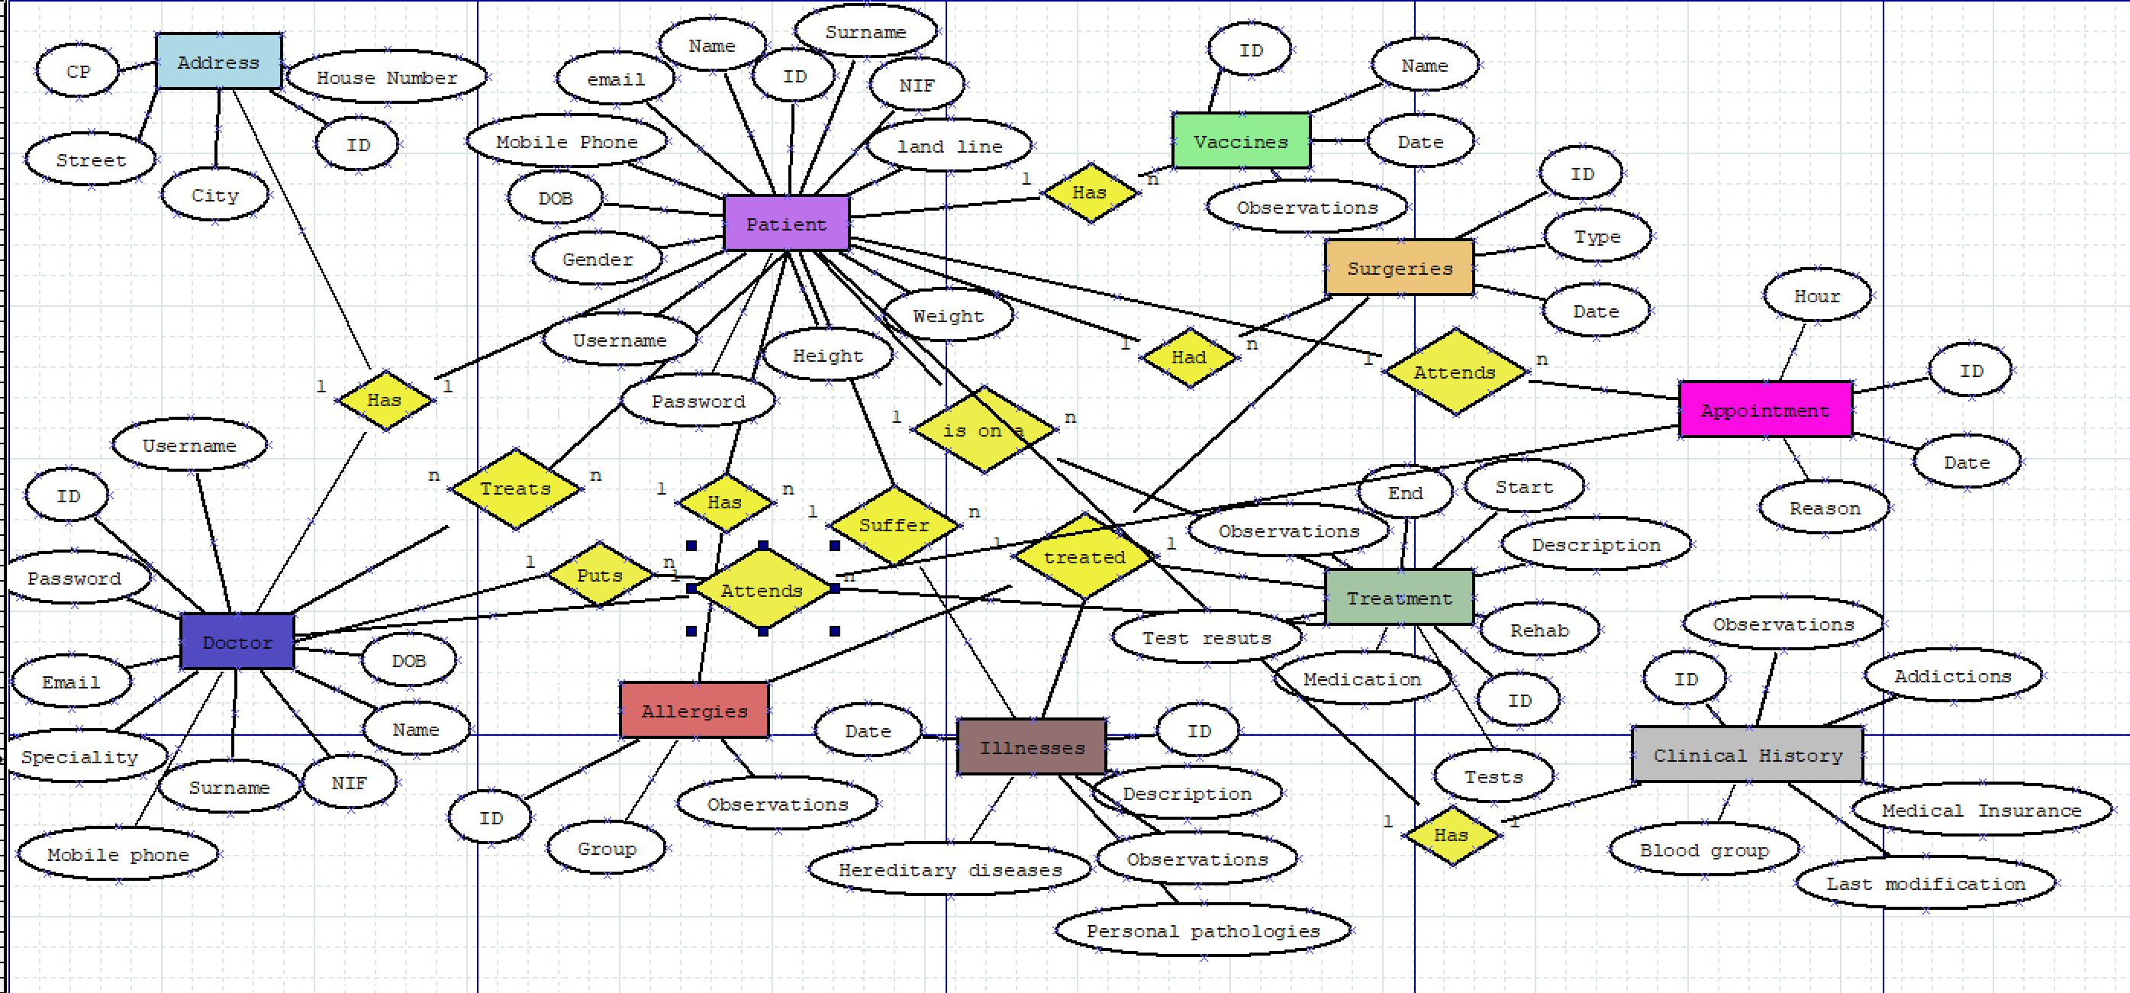
ER Diagram

Slide 6
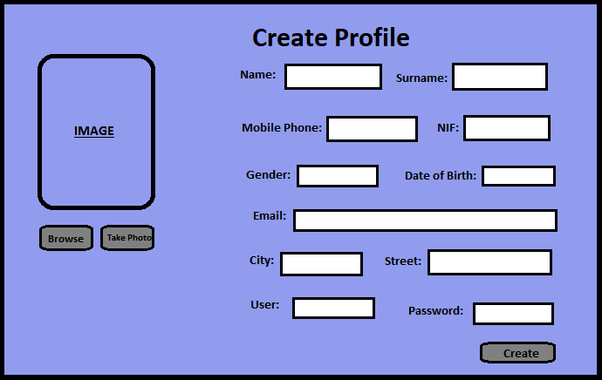
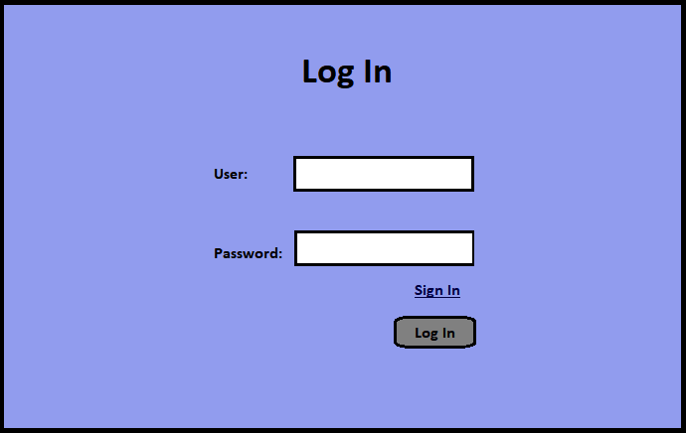
User interface

Slide 7
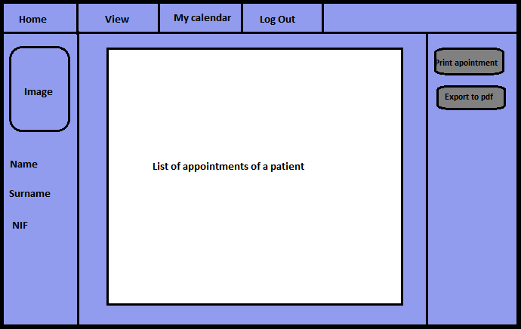
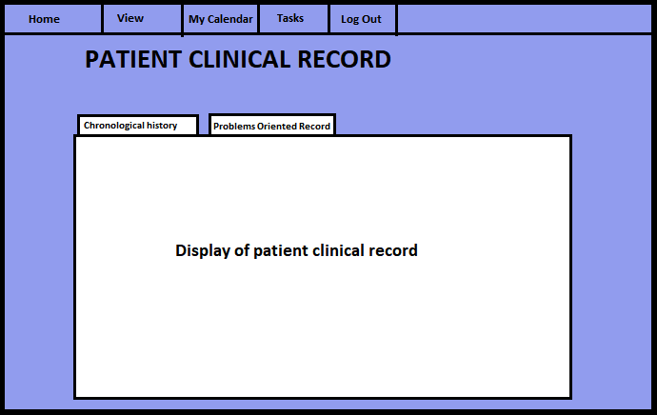

Slide 8
Thank you for your attention

